Slide 1

Our Journey to Diné Excellence
3Q2026 Report
Presented by
Melinda White, RN, MSN
Chief Executive Officer

Slide 2
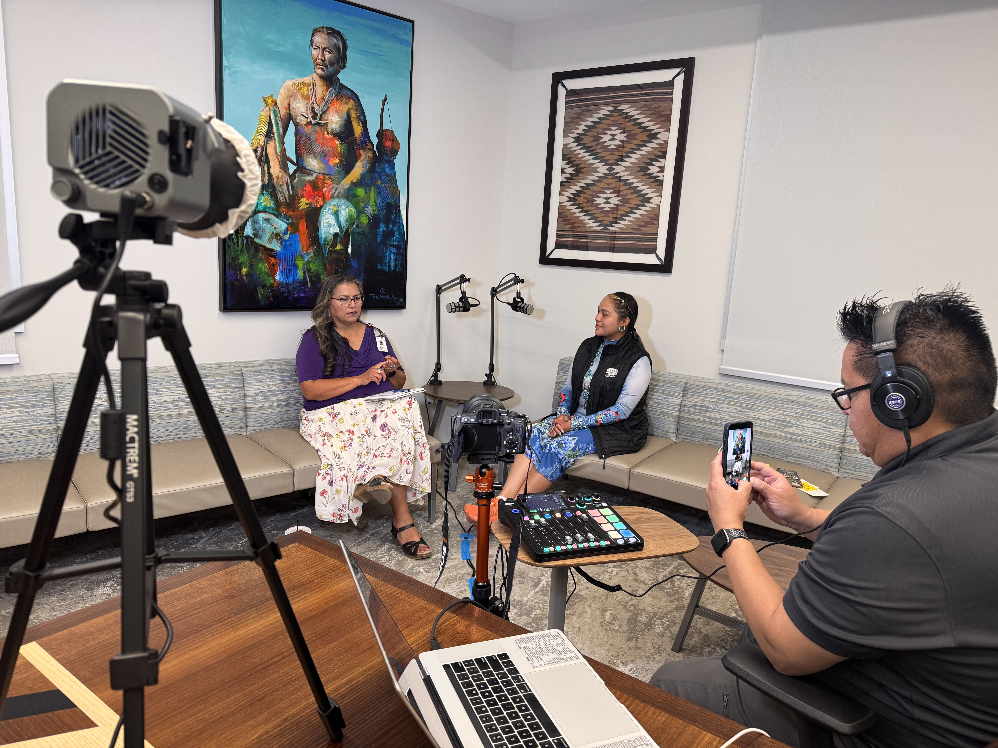
Advancing our Self Determination Path - Highlights
Joint Commission Accreditation
Continue to expand services
Capital Projects moving forward
  Next phases with tiny homes
  Hogan Complete
HB2177 Bill signed by the Governor
Patient Experience Department growth

Slide 3
Our High Reliability Organization Journey
COMPLETE
Survey Readiness
Mock tracer surveys
Staff education blitz
Policy & procedure review
Mock Survey from JCR
QM Training with JCR
Standdown checklist
Pocketbook Survey Readiniess
Environmental Rounds with multidiscplinary team
Tracer activities
COMPLETE
On-Site Survey
Joint Commission on site
Tracer methodology
Leadership interviews
Rural Health Clinic
Primary Care Medical Home Certification
Critical Access Hospital
Home Health – Durable Medical Equipment
IN PROGRESS
Evidence of Compliance
No high risk findings!!!
ESC submitted for RHC and PCMH
  Accreditation letters received
ESC submitted for CAH and HH – DME
  Accreditation letters received
Corrective actions underway
ESC reporting to QC
No 60-day follow-up
TARGET
Full Accreditation
Anticipated 3Q2026
Continuous survey readiness
Reaccreditation cycle soon for the Laboratory
Joint Commission application will be updated to include:
  Labor & Delivery
  Dialysis
A Significant Milestone — Joint Commission Accreditations & Certification Awarded
ACCREDITED
RHC
Rural Health Clinic
ACCREDITED
CAH
Critical Access Hospital
ACCREDITED
HH–DME
Home Health & DME
CERTIFIED
PCMH
Primary Care Medical Home
Joint Commission — Full Accreditation and Primary Care Medical Home Certification awarded, 3Q2026, with no high-risk findings.

Slide 4
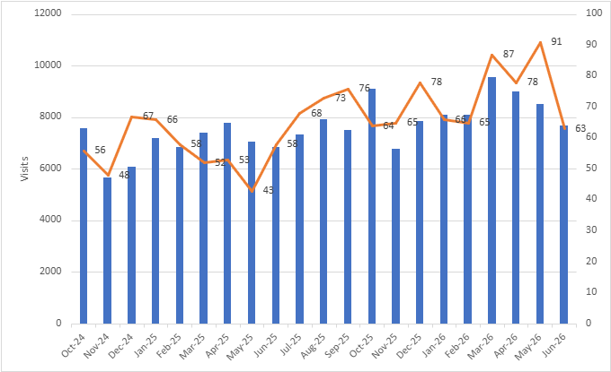
Scalable Growth
Admissions & Visits | 3Q2025 | 3Q2026
Inpatient Admissions | 451 | 474
ICU | 33 | 101
Swingbed | 26 | 82
Total Admissions | 510 | 657
Outpatient Clinic | 10,025 | 11,044
Behavioral Health | 2,456 | 3,864
Emergency Department | 9,699 | 10,837
Pharmacy (visits) | 26,420 | 32,851
Total Visits | 46,273 | 56,364
3Q2025 → 3Q2026 Growth
+19%
Visits
+28%
Inpatient
+12%
ER
+97%
Behavioral

Slide 5
Our Promise to Bring Services Closer to Home
General Surgery Services implemented- endoscopy and scheduled surgeries
Prenatal and postnatal services implemented. Deliveries will be starting in September 2026
Outpatient Dialysis services being implemented.
Transitioning the Medical-Telemetry Inpatient Unit to a Medical-Surgical Inpatient Unit.
Tele Stroke/Neurology program implemented
Specialty Clinic Services-Cardiology, Neurology, Infectious Disease, Rheumatology, Gastroenterology, and Surgery.

Slide 6
Inpatient, ICU, and ED 3Q2026 Data
Inpatient
Intensive Care Unit
Emergency Room
Inpatient ALOS: 6.68
Average census per day: 11.2
Top Admitting Diagnosis
Pneumonia
Sepsis
ETOH
Swing Bed ALOS: 18.53 days
Average census per day: 6.47
Top Admitting Diagnosis
Abx Treatment
Physical Therapy
Wound Care
ICU ALOS: 2.11
Average census per day: 0.42
Top Admitting Diagnosis
Sepsis
DKA
ETOH / Alcohol related
Total patients seen: 3,361
Average census per day: 37
Average throughput
Admission to Doc: 35 mins
Admission to Discharge: 197.3 mins
Transfers: 4.23%
Primary reason for Transfers
General Surgery
Trauma
Neurosurgery
Top Five ED Chief Complaints
Upper Respiratory Infection
General medicine
Abdominal pain/nausea/diarrhea
Extremity injuries
Extremity problems

Slide 7

Hospital-Wide KPIs
Pillars | Goals | 1Q2026 | 2Q2026 | 3Q2026
People | Turnover rate will remain under 10% | 1.6% | 1.2% | 1.8%
Growth | Will increase patient volume by 7% in comparison to FY2025 | 24% | 20% | 19%
Service | 95% of patients will be please with the care they receive | 91% | 91% | 94%
Quality | At least 70% of all outpatients will be empaneled to a PCP team *increased in 3Q2026 | 40% | 60% | 64%
Quality | Reducing the ED throughput will be at or less than state benchmarks - 180 mins | 180 | 170 | 197
Finance | Accounts receivable over 180 days will not exceed 25% of the entiring aging schedule | 27% | 28% | 25%
Finance | Quarterly cash collections will be at or >13.5 million | $14.6 | $15.6 | $16.1
Community | Vaccinate 3000 relatives with the Flu vaccine. | 77% | 81%
Community | Implement 24 community health events (2 per month) | 100% | 100% | 100%

Slide 8
K’é - Your Voice Matters
We listen — and we act. Caring for every relative as family means every voice shapes how we deliver care.
COMPLIMENTS
70
0% vs 2Q2026
COMPLAINTS
13
0% vs 2Q2026
GRIEVANCES
13
0% vs 2Q2026
Voice of the Relative — Top Themes
Communication Challenges
Customer Service
Care Coordination
PRC process
Concerns & Our Response
PRC clarity → expand PRC eligibility education
Appointment access → added clinic hours
90% of grievances resolved within 7 days
Customer Service – AIDET refresher
96 voices heard this quarter — every compliment, concern, and grievance acknowledged and answered.

Slide 9
Our SMH Family are the Foundation of our Success
Our SMH Family are the Foundation of our Success
89% of all our employees are Navajo
Vacancies are primarily Nursing and Allied positions (Imaging)
HR policy currently under revision
KEY TAKEAWAY
Headcount has held steady near 450 even as vacancies stay around 28% - retention is strong while we work to fill open roles.

Slide 10
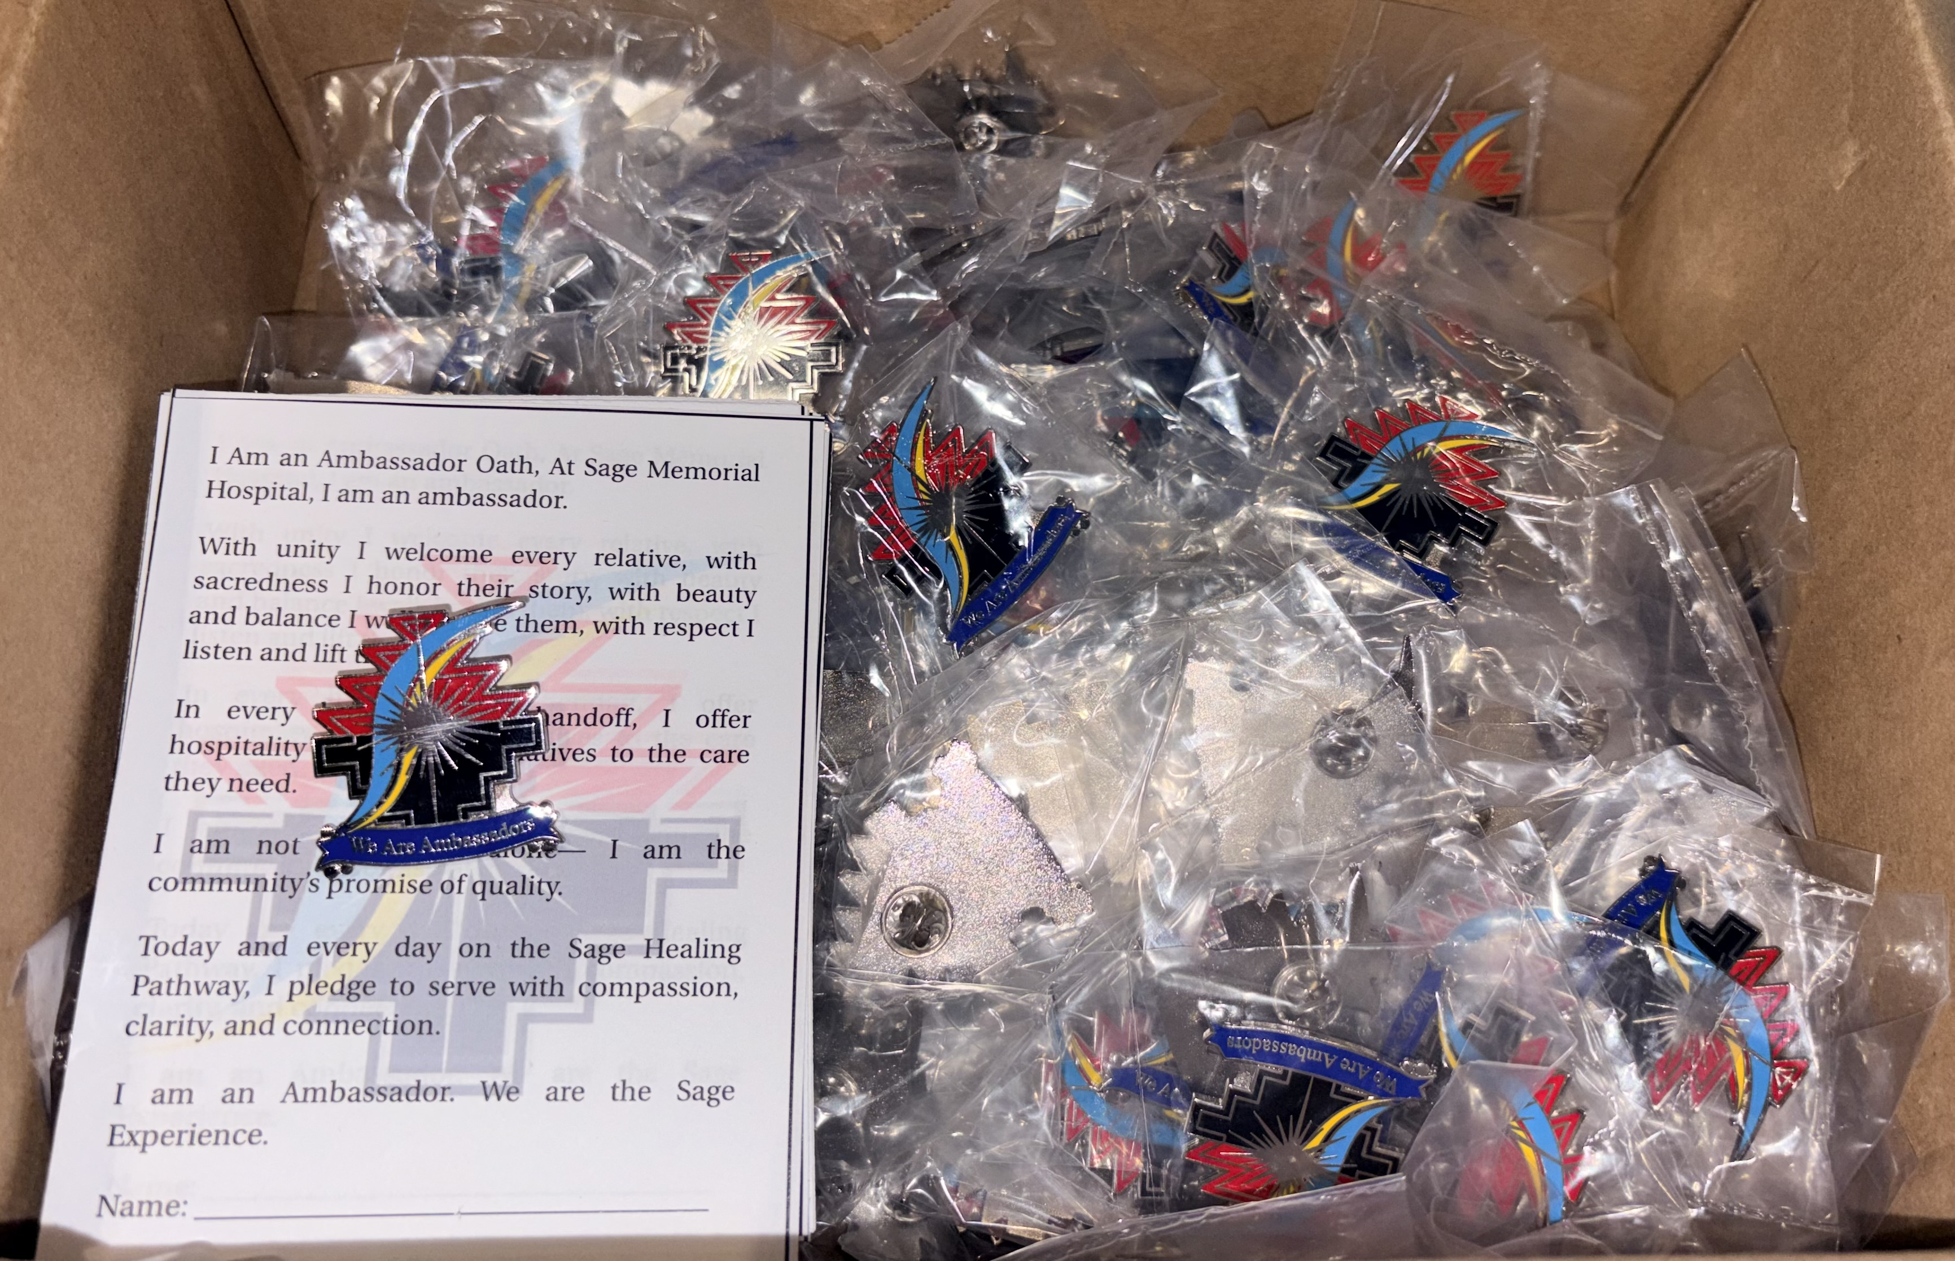
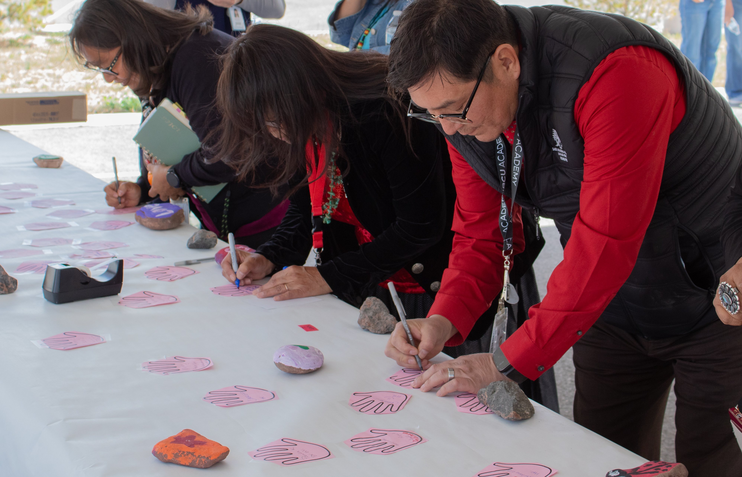
Our Journey to Diné Excellence
📷
Photo: “I Am an Ambassador” Pin Ceremony
Insert photo of staff receiving their ambassador pins
📷
Photo: Taking the Pledge & Handprints
Insert photo of the pledge wall and handprint mural
Living our Ambassador Pledge
Team members take the Ambassador Pledge and add handprints to our community mural
The pledge reflects K’é — caring for every relative as family

Slide 11

ASU Nursing Program – Learn Where you Live
Current partner locations
Ganado region - SMH
Gila County (Payson/Globe) region
Parker region
Tucson region
An Accelerated BSN 12-month program
Accessible & affordable
Complete nurse coursework via a mix of live sessions – ASU Sync technology & in-person experiences
In-person lab & clinical experiences at SMH
ASU is a nationally ranked BSN program, expert faculty and strong NCLEX pass rates

Slide 12
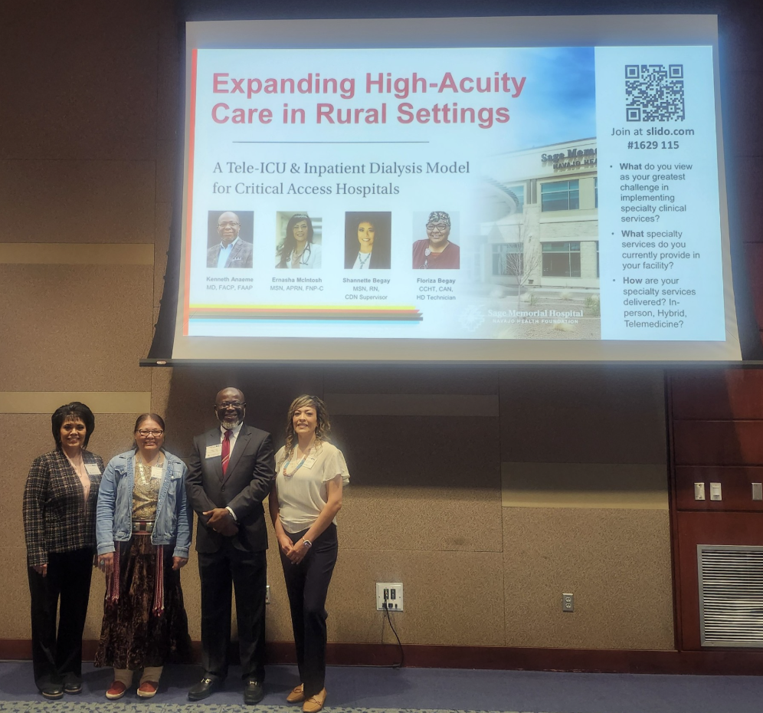
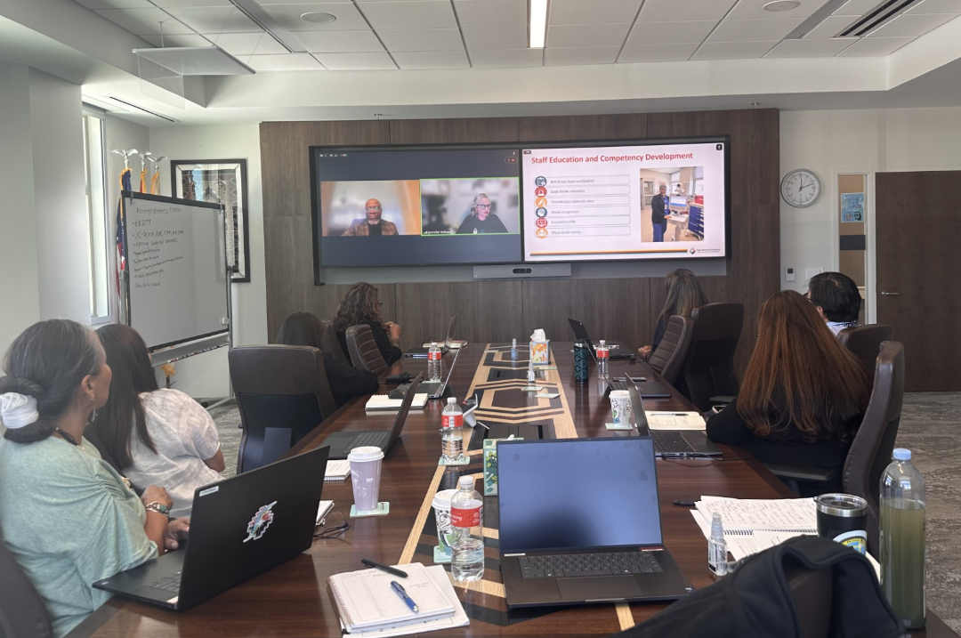
Sharing Best Practices
2026 Arizona Stroke, Tribal & Rural Health Summit
Presented door-to-needle outcomes and rural stroke workflow
Strengthened referral network with regional stroke centers
Annual Arizona Rural Health Conference
Presented Tele-ICU and Dialysis Program
Shared best practices with other Critical Access Hospitals
Highlighted rural telehealth and workforce partnerships

Slide 13
Construction Project Timelines
 |  |  | FY 27
Project | QT3 FY26 | QT4 FY26 | QT1 FY27 | QT2 FY 27 | QT3 FY27 | QT4 FY27
Dialysis
Tiny Homes
Master Plan
As’ah Dilzin
T.I. Proj
Wellness Center Expansion
Apartments at Sage #2
Support Service Building (SSB)

Slide 14
Operational Hurdles
Challenges | Effective Strategies / Problem Solving Efforts
Land Lease for NHA buildings | Presented to the Cornfields Chapter – tabled, renovation on hold Renovation at the Ganado – As'ah Dilzin Visiting NN Land on a weekly basis to ensure transition.
Housing Shortage | Tiny Homes ready to be ordered – 15 homes Replacing the older manufactured homes; returning Gallup trailers to Ganado Planning for Apartment building
Funding for Elder Care | Completed a proforma for the Elder Care Services Reviewing the RHTP grants available Seeking philanthropy fundings to offset cost

Slide 15
Quarterly Goals
3Q2026
4Q2026
DONE
✓ Complete a Pro Forma for the elder care services
✓ Interim review on Audit findings
✓ Accounting outsource ends
✓ Patient Experience Roll Out
✓ Update the 2023 – 2027 Strategic Plan
✓ Begin purchasing tiny homes
PENDING
▢ Introduce AI in the finance department
▢ Master Plan kick off for Campus Wide
▢ New Service: Labor & Delivery Services
▢ New Services: NEMT and Interfacility Transport
▢ FY2027 Budget
▢ FY2027 AFA/CSC and 105(l) negotiations
▢ Submission for RHTP grants
▢ Submission of AIHP application with AHCCCS

Slide 16
CEO Update to the 638 Association
Focus Area | Highlights & Advocacy Priorities
Accreditation & Compacting Capacity | Full Joint Commission accreditation achieved 3Q2026 RHC, CAH, HH/DME accredited and PCMH certified – no high-risk findings Strengthens third-party revenue and self-governance capacity
Federal Funding & 105(l) Leases | FY2027 AFA/CSC and 105(l) lease negotiations underway FY2021-FY2022 CSC CDA claims negotiation complete Pursuing RHTP grants and philanthropy to offset Elder Care costs
Expanding Services Closer to Home | Surgery, prenatal/postnatal care, and outpatient dialysis added Deliveries begin Sept 2026 19% year-over-year visit growth
Navajo Workforce Development | 89% of our workforce is Navajo ASU “Learn Where You Live” BSN pipeline growing local nurses
Policy & Advocacy Priorities | HB2177 signed by the Governor advancing self-determination Partnering with the 638 Association on rural health funding

Slide 17
Thank you!
Questions?

